Slide 2
About Me
5th year student at ANU
Bachelor of Engineering (R&D) Honours/ Bachelor of Science
Majors: Renewable Energy Systems & Chemistry
Minors: Climate Science and Policy
Thesis Topic: Energy Security in the National Electricity Market under future climate disaster scenarios
Notes:
Read off the slide
As you can see my background is more in Engineering and Physical Sciences
Database design and SQL is all new to me, concepts and language will sound like me trying to explain to myself six weeks ago.

Slide 3
The Project

Slide 4
The AWRA-L Model Dataset
Water Balance dataset from the Australian Water Resources Assessment Landscape model from BoM
Daily gridded spatial data from 1911 – 2015, 0.05 deg spatial resolution
Variables:
Total Moisture in top, shallow, and deep soil layers
Total and Potential Evapotranspiration
Total runoff Deep soil layer drainage
Available online in netCDF file format – 280MB
841 × 681 × 365 ≈ 210 × 10⁶ datapoints per file
Notes:
And there are 735 files spanning 105 years and 7 variables, So quite a bit of data.

Slide 5
Similar Climate Data Portals
AWRA-L: http://www.bom.gov.au/water/landscape/
BoM Climate: http://www.bom.gov.au/climate/change/#tabs=Tracker&tracker=trend-maps
IPCC WG1 Interactive Atlas: https://interactive-atlas.ipcc.ch/regional-information
NOAA Climate: https://psl.noaa.gov/ipcc/cmip6/
NOAA SST: https://www.psl.noaa.gov/data/gridded/data.noaa.oisst.v2.html#plot
Copernicus EU: https://cds.climate.copernicus.eu/cdsapp#!/dataset/projections-cmip6?tab=form
Notes:
A lot of the big governmental meteorology institutions publish freely available data for climate and weather.
I’ve used more than a few of them in my experience as a student, and they largely follow similar format, on the front end at least.
Walk through examples:
AWRA-L: select variables
Pre-set aggregations, that aren’t very flexible for a lot of the queries a user might have
BoM: Gridded spatial data or spatially aggregated timeseries
I’ve heard the backend of portals like this consist of pre-generate images and don’t involve any actual querying of data.
IPCC: Select temporal coverage
NOAA: I lot of the ones I’ve worked with are outputs from Global Climate Models so you can select data from the individual model too
For climate projections, there’s also the consideration of emissions scenarios
Some allow you to specify a bounding box
NOAA & COPERNICUS: And then most allow you to download the data in some format. I’ve seen CSV and ZIP files, but for the more scientific uses NetCDF seems to be most common
These kind of data resources have a number of limitations that I’ll talk about in a minute

Slide 6
RDBs for Gridded Climate Data
This has mostly been shown to be an impractical solution in the past
Gridded climate datasets are typically too large to be effectively queried by a Relational Database:
The AWRA-L dataset would have ~10¹¹ data points all together
Other products have great resolution and coverage
Recent Developments in Columnstore technology for relational databases show potential, and the concept is worth revisiting
Notes:
Although I had another look this morning, and found a bunch of new work on this in the last 18 months are so, trying out a number of new methods.
The AWRA dataset I mentioned earlier contains on the order of hundreds of billions of data points all together
This is a hydrology dataset, so a daily temporal resolution is sufficient
But if you think of other applications like atmospherics or ocean circulations in a global climate model, you would probably be looking at hourly and perhaps even sub-hourly data.

Slide 7
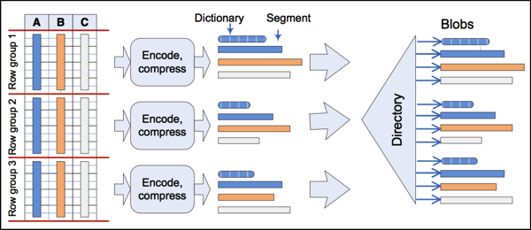
Columnstore Indexes
Source: http://research.microsoft.com/apps/pubs/default.aspx?id=193599
Notes:
The typology around this can be a bit confusing,
Typical rowstore table format; index is a separate structure.
Separating by columns enables better compression
Less efficient if you are seeking a single value, because you have to go through the whole segment
But much faster for queries that seek large chunks of data

Slide 8
Project Framing
Essentially a ‘Proof of Concept’ for storing gridded climate data in relational databases with columnstore
Using the AWRA dataset, but aiming to keep it general to all gridded climate datasets
Addressing limitations of existing platforms and netCDF file distributions:
Increasing the scope of data aggregation and analytics capability
Accessibility of underlying data formats
Notes:
Read off the slide
Enabling a broader scope of aggregations and customisability
To generate insights from climate and environmental data, you often need to look at long term trends and all kinds of aggregations.
With a relational database all kinds of queries and aggregations would in theory become much easier to manage
Barrier to entry – pretty hard to access and analyse netCDF data if you’re not confident with coding
One of the reasons I was interested in this project was my own experience with netCDF files in uni.
It’s a convenient format for sharing and storing climate data, but it can be a bit of a headache to use.

Slide 9
Project Scope
NetCDF
SQL Server
Query Results
Visualisation/ Tabular Data
PHASE 1:
INGESTION
Moving the data from NetCDF files on a hard drive and into a SQL Server
PHASE 3:
INTERFACING
Making the Data Warehouse accessible through some UI
PHASE 2:
DATAWAREHOUSE ASSEMBLY
Optimising the Data Warehouse structure to minimise runtime, I/O cost, and CPU runtime for a broad range of queries.
Notes:
PHASE 1:
Ingestion sounds a lot simpler than it is
For this kind of data warehousing workload it only has to be done once
PHASE 2:
This is really what the project is actually about.
Experimenting with different structures, schema, indexing, and all kinds of measures that might allow for fast query processing
Cover a breadth of different query types that we might anticipate from a user.
Ultimately runtime is the most important stat here.
PHASE 3:
The purpose of the project is really satisfied by the first two phases, so this one is more aspirational
Hoping to finish ahead of schedule and have time to establish some kind of user interface through a web service or something like that
More of a polishing

Slide 10
Progress

Slide 11
Ingestion
Pushing 3D array in NetCDF into a 2D in SQL Server
Tried a number of Python-based methods:
First method took: ~22 hours per file
Final method took: ~6 minutes per file, with a 1GB CSV intermediate
280MB NetCDF > 1GB CSV > 450MB SQL columnstore table.
Just under 3 days to ingest the full AWRA dataset
Notes:
There were a number of considerations here about how best to execute this.
The difference in runtime between the first and final methods highlights this.
Final method involved reading the NetCDF data into a python array, then writing into a CSV and bulk inserting to an SQL table
Unsure why, but any attempts to push directly from a python array to a SQL table required at least an hour.
We expect there’s probably a much faster and efficient way to perform the ingestion in C# or other languages, although I anticipate the tradeoff of time for me to learn another language well enough to perform it is not worth it.
Due to storage limitations, currently only working with a small subset of the data, but the process is scalable.

Slide 12
DataWarehouse Structures
Main Structures to be considered
Rowstore, STAR-schema
Columnstore, STAR-schema
Columnstore, One Big Table (OBT)
Other methods to experiment with on top
Query tuning, segment elimination
Manipulating data types and formats
Hybrid index structures
Table Partitioning
Annual and monthly pre-aggregations

Slide 13
Standard Queries
STANDARD QUERY 1: | Raw gridded spatial data for a given timestep
STANDARD QUERY 2: | Absolute maximum Gridded spatial data for a given year
STANDARD QUERY 3: | Quantile (decile) gridded spatial data for a given month within a wider range (10, 25, and 50 years)
STANDARD QUERY 4: | Long-term average gridded spatial data (tested over 1, 10, and 50 year periods)
STANDARD QUERY 5: | Gridded spatial anomaly of (given day, monthly average, annual average) with respect to a 30-year base period.

Slide 14
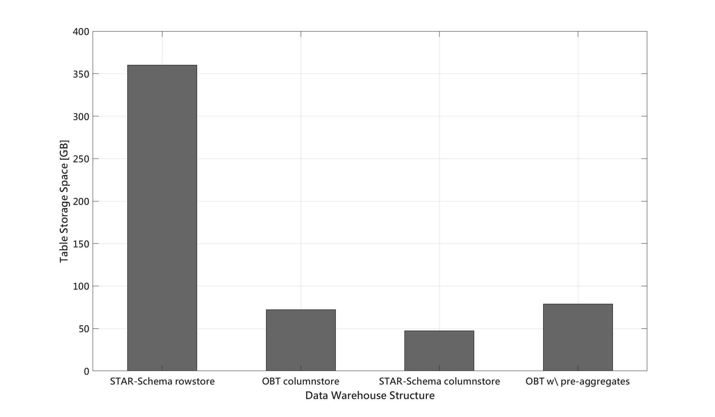

Slide 15
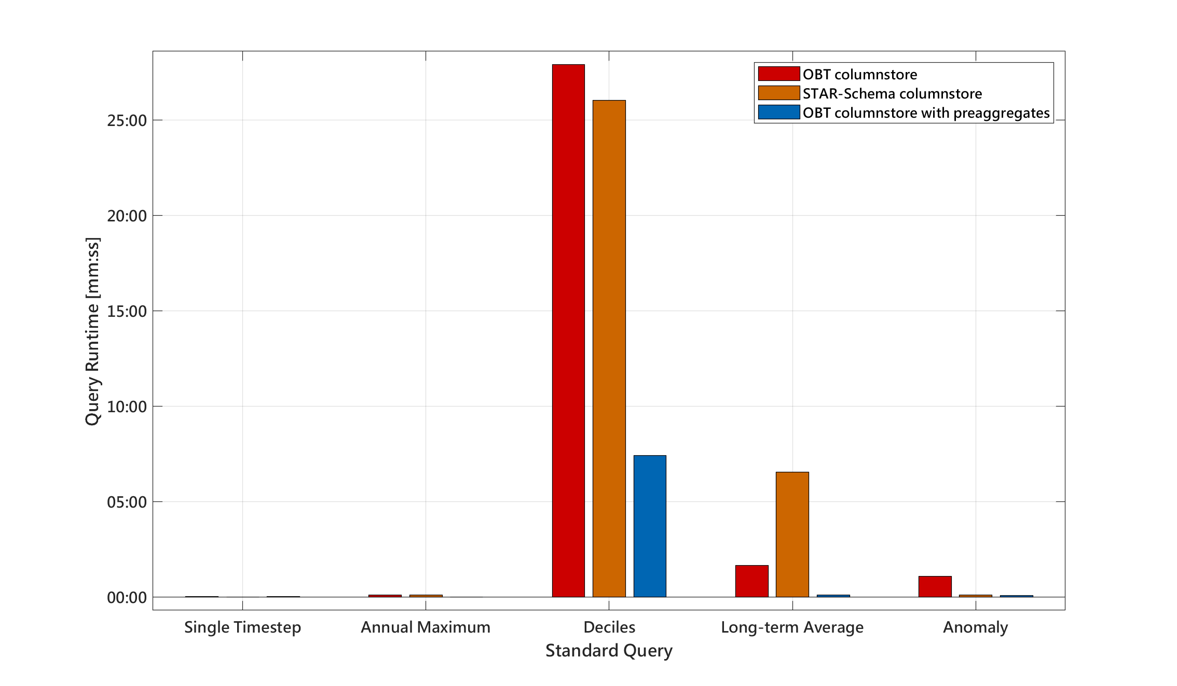

Slide 16
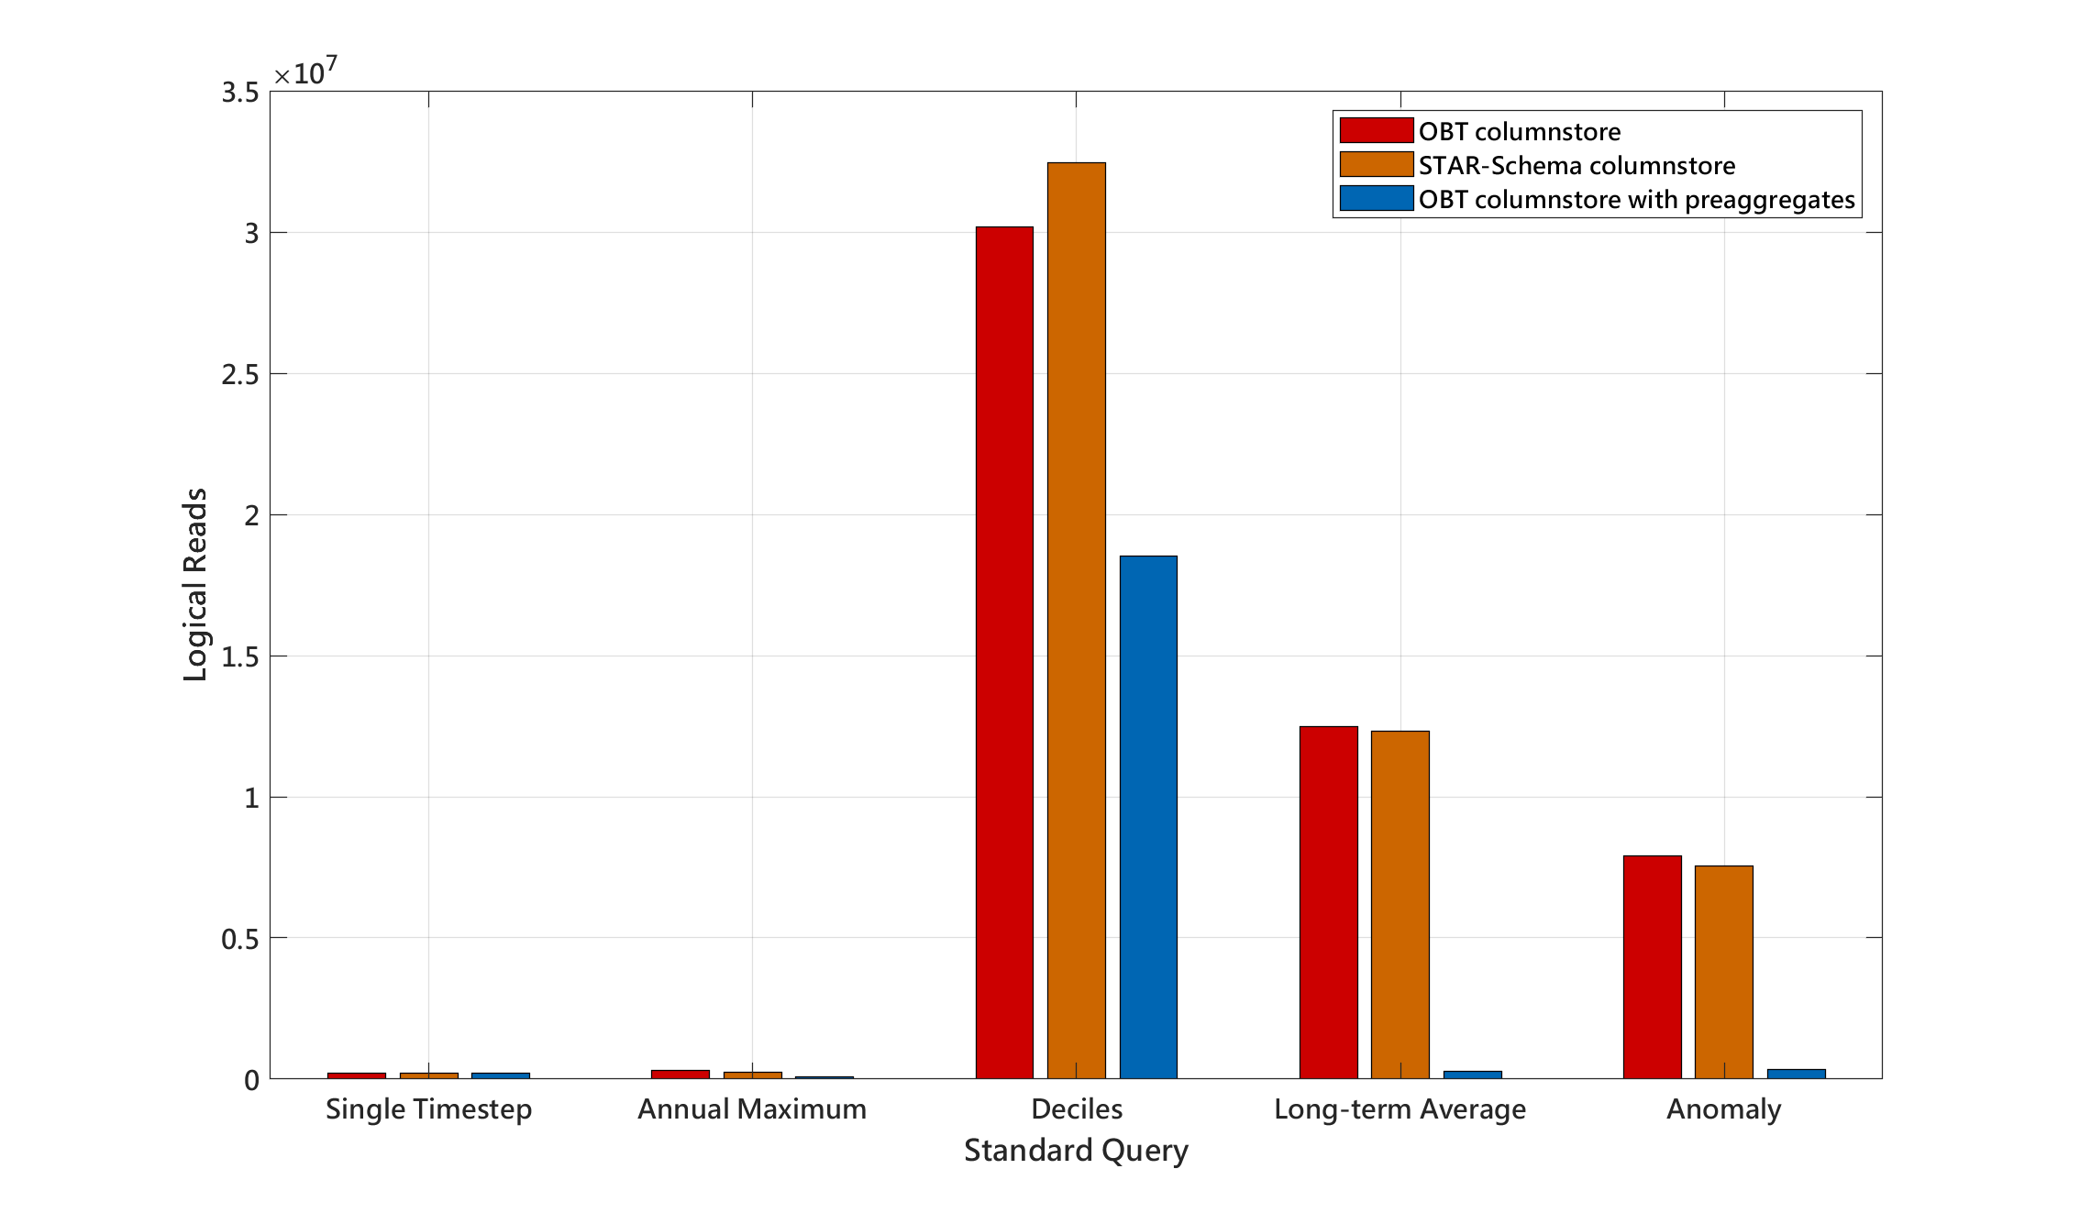

Slide 17
Next Steps
Wrapping up Phase 2 experimentation
Enabling spatial aggregations to produce timeseries data for a user specified region
Two standard queries already designed, although lacking a method
Aspiring to enable users to slice the gridded data with shapefiles or bounding boxes
Establishing a User-Interface for phase 3
Platform still not decided

